Slide 1
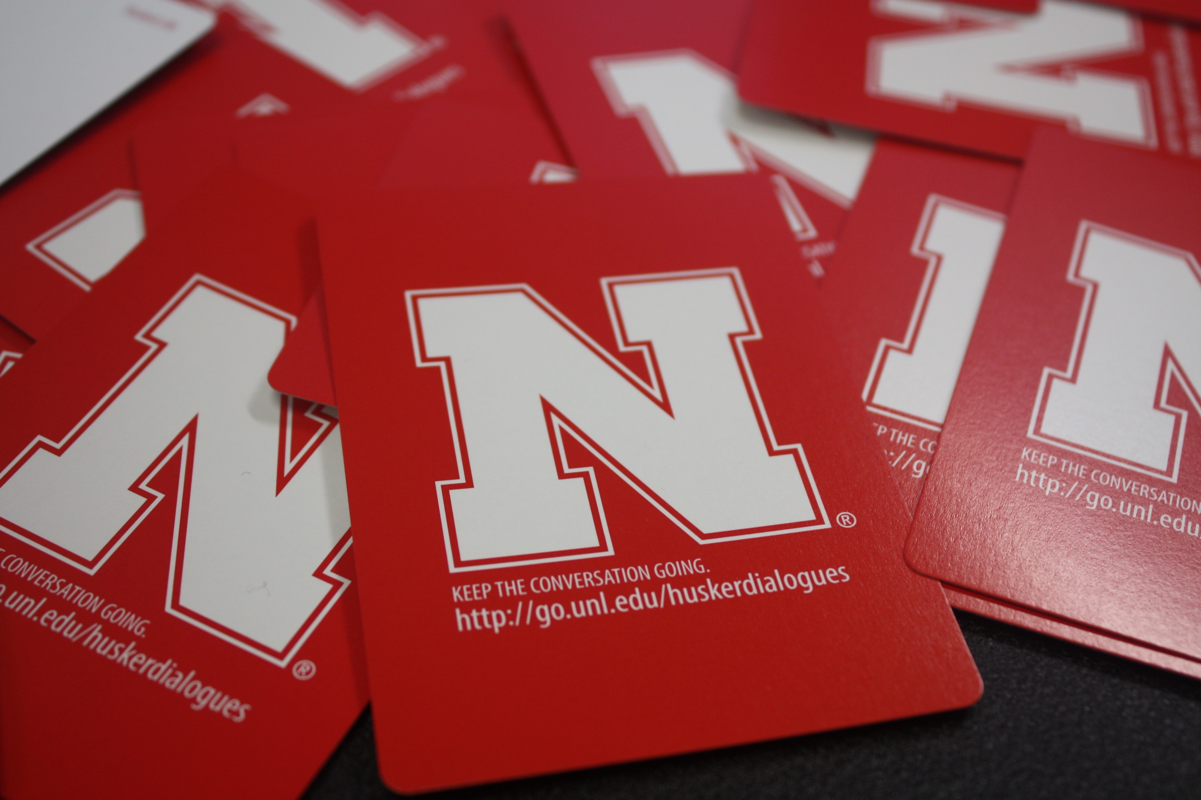
FACILITATOR TRAINING
HUSKER DIALOGUES 2017

Slide 2
Introductions
How many attended Husker Dialogues?
What did you experience?
2017 Husker dialogues training
Notes:
Purpose of the training is to better prepare facilitators for the Husker Dialogue experience
a. based on participant feedback the committee recognized the need to increase facilitation skills among faculty, staff and students participating as conversation guides
Training is divided into 3 sections
a. first section is to better understand the who, what and why
b. second section is focused on skill development
c. thrid and final section allows participants to practice using questions from the Husker Dialogue card deck

Slide 3
Why Husker Dialogues?
Showcase importance of dialogue in a university
Model respectful ways to participate in dialogue
Articulate university values about inclusion for academic excellence
Demonstrate how UNL values ethnic and cultural diversity
Prepare one another to live and work in a global society
2017 Husker dialogues training

Slide 4
This year’s program
Wednesday, September 6, 2017
6:30 pm - doors open at Devaney Center
7:00 pm - program begins
ECMO Video
Live student performances
7:30 pm – move to small group discussion
2017 Husker dialogues training

Slide 5
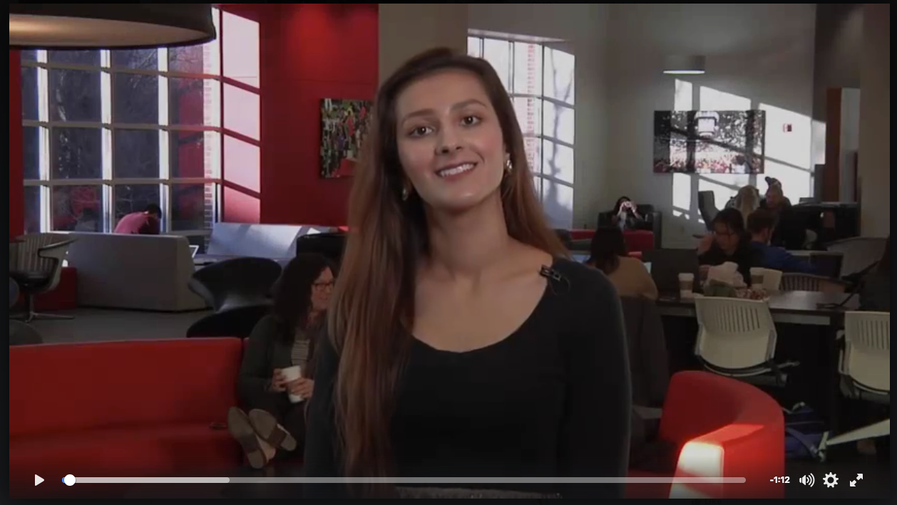
Emphasizing Student Perspectives
“We’re All Huskers”
2017 Husker dialogues training
Notes:
a. Trying to instill in our students, faculty and staff, that we care about our University community and we want to make it a welcoming environment for all students.
b. Ask participants to define and discuss diversity
c. Show the ECMO video
The Executive Council of Multicultural Organizations (ECMO) serves as the official representative body of participating registered student organizations representing multicultural student interests to university officials and the Association of Students of the University of Nebraska. The Council shall facilitate the communication of student concerns regarding issues of race and discrimination to the Office of the Vice Chancellor for Student Affairs and relevant university entities.

Slide 6
Goals for Facilitators
Create an inclusive environment
Support constructive discussions
Encourage participation
Help others share and reflect on experiences
Raise awareness of how cultural lenses shape our perspectives and understandings
2017 Husker dialogues training
Notes:
Introduction – effective facilitation of a discussion involves the recognition and employment of different perspectives and different skills to create an inclusive environment. In order to do so, it is important to consider the features of effective discussions, and conditions that promote small group interaction and engagement. Discussion is a powerful mechanism for active learning; a well-facilitated discussion allows the participant to explore new ideas while recognizing and valuing the contributions of others. (Roles of Discussion Leaders (adapted from Handelsman et al. 2006)

Slide 7
Preparing to be a Facilitator
Jot down responses to these questions:
What surprises or challenges me about issues of diversity and inclusion?
What behaviors are familiar or make me feel comfortable?
What behaviors challenge me?
2017 Husker dialogues training
Notes:
As a Husker Dialogues facilitator, please stop and consider the following:
What do I bring to the group?
What surprises or challenges me?
What behaviors are familiar or make me feel comfortable?
What behaviors challenge me?
Facilitator Dos and Don’ts
Do
Encourage participants to introduce themselves
Use inclusive language
Ask for clarification if unclear about a participant’s intent or question
Treat participants with respect and consideration
Don’t
Use certain conventions or language that will exclude certain groups from understanding the context of the discussion, or make them
Assume participants all have the same expectations when the group first convenes
Over-generalize behavior or have stereotypical expectations of participants (tokenism)
Use (or allow others to use) disrespectful language or tone, or disrespectful non-verbal communication.
Convey a sense of self-importance or superiority
Allow only the dominant or more verbal participants to take over the conversation
Discourage alternate views or counter-arguments
Try to be someone else – be yourself

Slide 8
List 5 people outside of your family whom you trust the most.
2017 Husker dialogues training

Slide 9
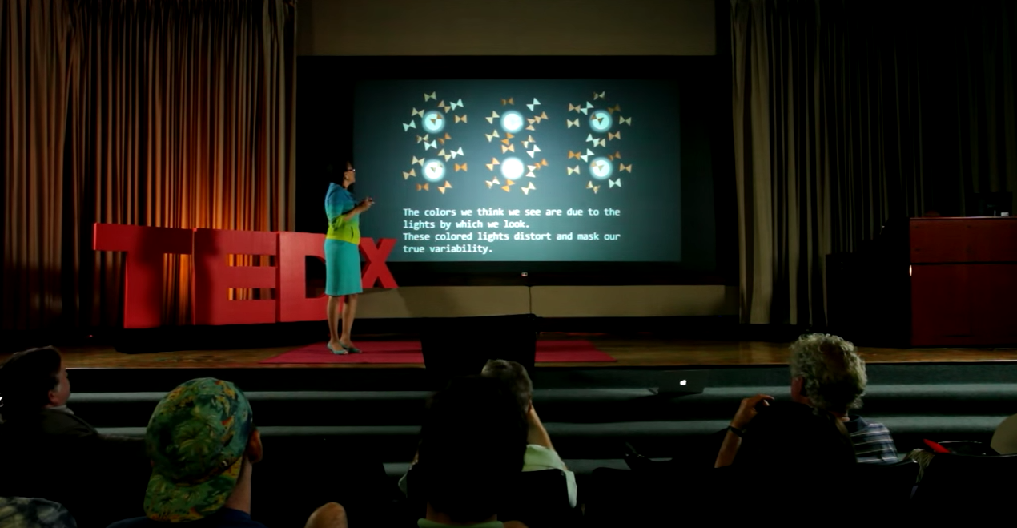
Building our Expertise
Allegories on Race and Racism - TEDx
2017 Husker dialogues training
Notes:
Purpose of Husker Dialogues
Show Video – Allegories on Race and Racism; https://www.youtube.com/watch?v=GNhcY6fTyBM (TedX Emory professor Tamara Jones)
To have open dialogues
To break down walls built by our differences and heal communities
To create and strengthen a welcoming and inclusive university community
To demonstrate how we as an institution value and appreciate the diverse ethnic and cultural makeup of our campus
Prepare students for a global society
Following the video, ask participants to silently reflect upon the video. Ask two or three participants to share their thoughts.

Slide 10
What two ideas or examples in this video helped you to think about your role as a facilitator? Did the video connect or speak to any of the concerns or questions that you originally listed?
2017 Husker dialogues training

Slide 11
Return to your list of 5 people. Classify the names by race, age, & gender Are there trends or patterns you see? Any gaps?
2017 Husker dialogues training

Slide 12
Microaggressions and cultural lens
If Microagressions Happened to White People (MTV News)
2017 Husker dialogues training
Notes:
Microagressions and cultural lens
If time allows – discuss how to spot micro-aggressions, cultural appropriation
See examples of microagressions from this video to initiate discussion – the video is flipped e.g., microaggression toward whites

Slide 13
How did this video make you feel? What did this video make you think about? How can you use this self-reflection to prepare for your role as a facilitator?
2017 Husker dialogues training

Slide 14
Create an inclusive environment:
Ask everyone to turn off and put away phones
Encourage participants to introduce themselves.
Set group guidelines for the discussion (e.g., Treat participants with respect, goals for event).
Use inclusive language.
Ask for clarification if unclear about a participant’s intent or question.
2017 Husker dialogues training
Notes:
Each Husker Dialogue facilitator can decide 1) to allow the group to establish guidelines, 2) use the guidelines listed below that were identified by the sub-committee or 3) a combination of the first two options.
Recommended guidelines:
Phones and computers shut-off
Be respectful. Don’t diminish or shut down another person’s experience.
Be open to the process.
Acknowledge that these are difficult conversations.
Be authentic and engaging.
Be sure to listen to what others have to say (to appreciate their journey and perspective).

Slide 15
Suggested small group discussion questions
Tonight you heard 5 students share experiences about themselves that you probably wouldn't know if you first met them. Would you like to share something about yourself that is important to you that someone might not know?
What is one question you have based on the students’ stories you heard tonight?
What one idea or issue did the students’ stories raise for you?
What is one idea or experience that you heard from the students’ stories that you want to learn more about?
How does being a student at the University of Nebraska inform or challenge your experience or knowledge related to diversity and inclusion?
How often does your life ask you to see yourself through a racial lens? A gendered lens? An American lens?
What can you do to become more inclusive?
2017 Husker dialogues training

Slide 16
Do’s
Don’tS
Ask follow-up questions.
Ask for further clarification.
Revisit previous comments &
integrate them into conversation.
Encourage others to share their
reactions
Be honest about your own blind
spots or confusion.
Allow only the dominant or more verbal participants to take over
Discourage alternate views or counter-arguments.
Use (or allow others to use) disrespectful language, tone or non-verbal signs.
Over-generalize behavior or have stereotypical expectations of participants
Try to be someone else – be yourself.
2017 Husker dialogues training

Slide 17
Strategies for addressing a quiet group
Start with pairs and ask one of the two to report
Set the ground rules that everyone needs to participate – start with more general questions and move to those more difficult
Start with journaling (on paper or on the phone)
Ask for questions from the group – each person reads a question
Start with an icebreaker – find commonalities
Start with “What makes it difficult to have conversations about diversity and inclusion?
On a scale of one to ten, how comfortable are you talking about diversity? Why is that?

Slide 18
Strategies for addressing microaggressions
1. What you have said meant this to me. What was your intention? What do others think? I heard you say this. What it felt like to me . . . . Did any able feel that way. Okay, nobody else felt that way but I’d like to share . . . .
2. Has anyone had an experience different from what was just said? Other perspectives might be . . . What’s another way someone might feel about that?
3. Let the group know that nobody is perfect but we strive to do including myself. (avoid providing a rationale or reason for avoiding self-improvement)
4. Excuse me, can you repeat what you said?

Slide 19
Practicing your Role
Imagine one or two scenarios or issues you may encounter during Husker Dialogues.
In a small group, brainstorm 2 strategies you would use to address this issue.
2017 Husker dialogues training
Notes:
Activity
As a large group brainstorm potential problems HD facilitators may encounter during the discussion
Examples
Participant who talks to much
Participant who doesn’t talk
A discussion that turns into an argument
Unclear or hesitant comments
A discussion that goes off track
A participant who attached the facilitator
Break into small groups and brainstorm one or more responses for at least two problems
Reconvene and report our on small group discussion

Slide 20
Questions?
What do you need that you did not get?
2017 Husker dialogues training

Slide 21
Questions

