Slide 1
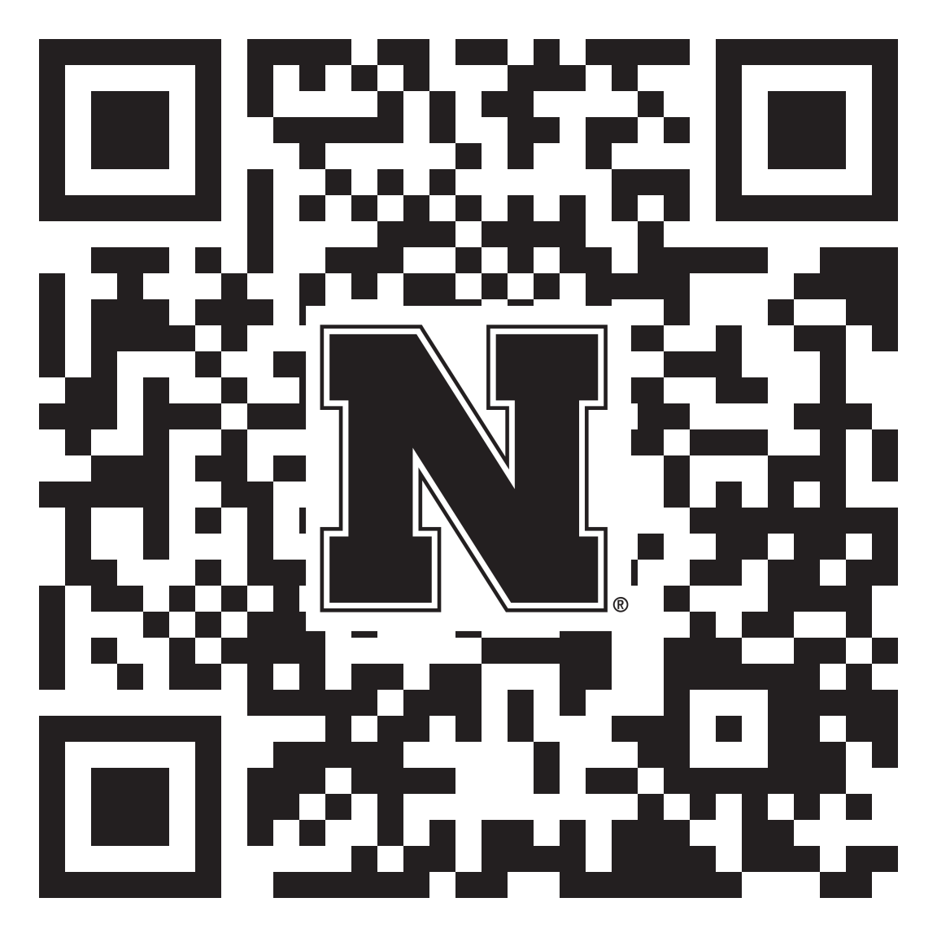
First-Year Huskers, Your Seat is Reserved!
Husker Dialogues is where first-year students learn to have brave conversations about building community, embracing difference, and becoming engaged on campus — all while being introduced to fellow Huskers from all different backgrounds.
Students hear from amazing student speakers before breaking out to chat in small groups with trained students, staff and faculty conversation guides about how to build an inclusive campus for everyone.
City Campus Coliseum:
September 6, 2023 7:00 – 8:30 p.m.

Slide 2
First-Year Huskers, Your Seat is Reserved!
What to expect from attending Husker Dialogues:
Increased awareness on the importance of respectful dialogue.
A greater understanding you belong to a university that values inclusive excellence.
Gain confidence to engage with peers from different backgrounds and to create a community at UNL.
City Campus Coliseum:
September 6, 2023 7:00 – 8:30 p.m.

Slide 3
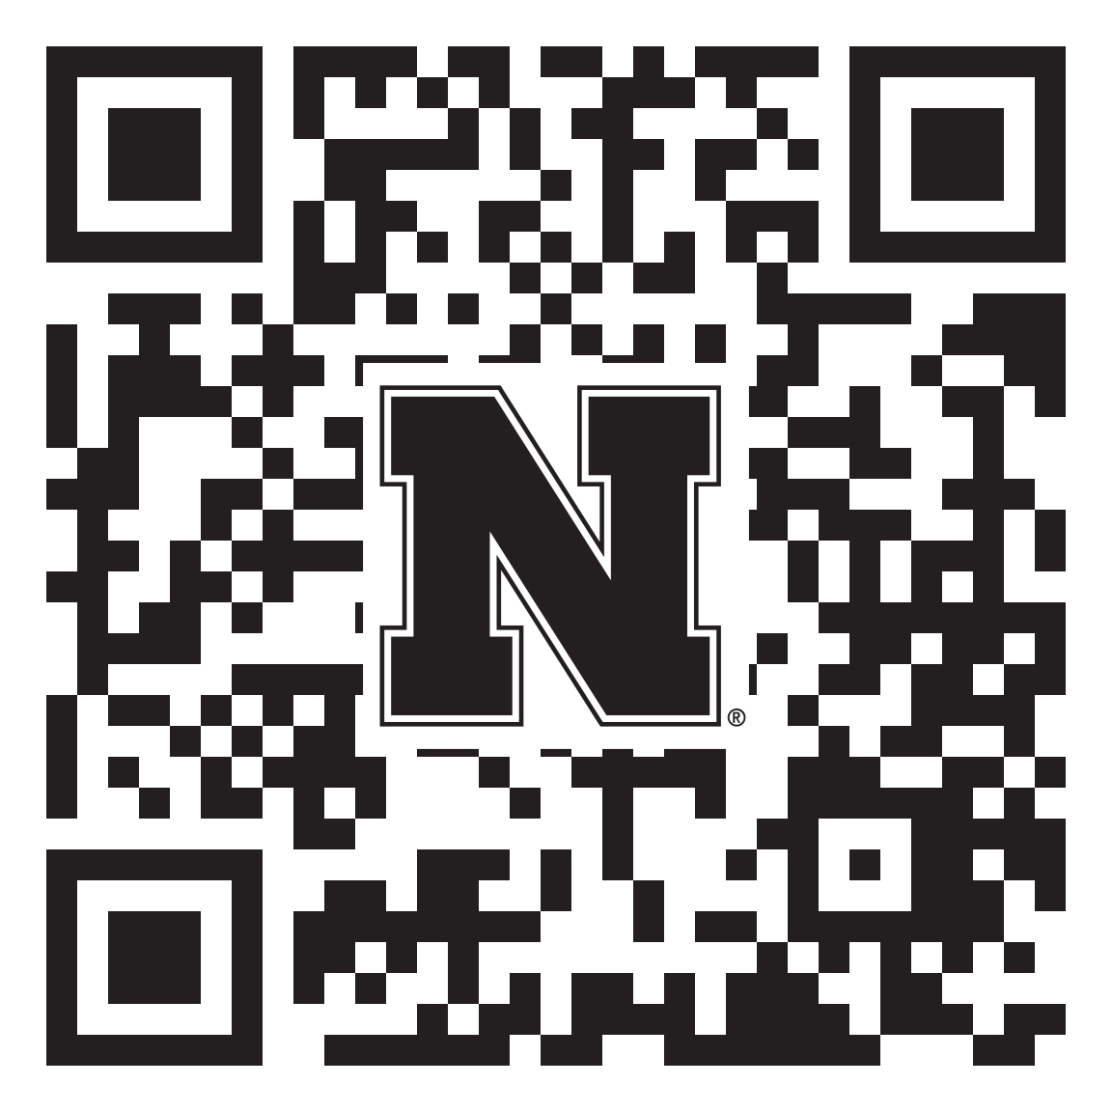
Juniors and Seniors – Be a leader!
Why become a Conversation Guide?
Volunteering to be a conversation guide is an excellent opportunity for hands-on practice in inclusive excellence.
It’s a career-building large-scale event that potential employers will notice on resumes. Training is provided, and everyone is welcome.
Your personal experience and leadership in this event are critical to student success at UNL. First year students need to hear from other students about the importance of inclusive excellence at UNL to continue building a welcoming environment.
Training is provided!
City Campus Coliseum:
September 6, 2023 7:00 – 8:30 p.m.

